Slide 1

PROPHET
TIME SERIES
CHICAGO
CRIME RATE

Slide 2

WHAT IS FACEBOOK PROPHET?

Slide 3
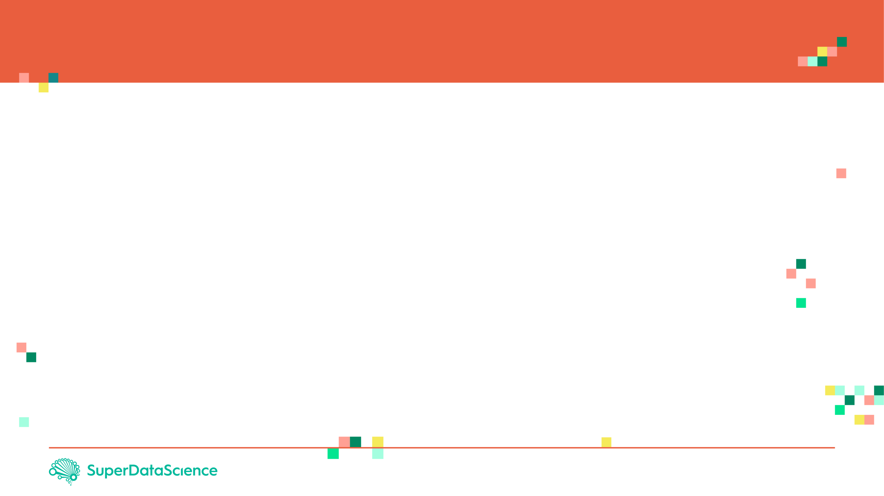
FACEBOOK PROPHET
Prophet is open source software released by Facebook’s Core Data Science team.
Prophet is a procedure for forecasting time series data based on an additive model where non-linear trends are fit with yearly, weekly, and daily seasonality, plus holiday effects.
Prophet works best with time series that have strong seasonal effects and several seasons of historical data.
For more information, please check this out:
https://research.fb.com/prophet-forecasting-at-scale/
https://facebook.github.io/prophet/docs/quick_start.html#python-api
NOTE:
You must install fbprophet package as follows: pip install fbprophet
If you encounter an error, try: conda install -c conda-forge fbprophet

Slide 4

FACEBOOK PROPHET
Prophet implements an additive regression model with four elements:
A piecewise linear, Prophet automatically picks up change points in the data and identifies any change in trends.
A yearly seasonal component modeled using Fourier series.
A weekly seasonal component.
A holiday list that can be manually provided.
Additive Regression model takes the form:
$$Y=β_{0}+\sum_{j=1}^{p}{f_{j}\left(X_{j}\right)+ε}$$
The functions $f_{j}(x_{j})$ are unknown smoothing functions fit from the data
Reference: https://research.fb.com/prophet-forecasting-at-scale/

Slide 5
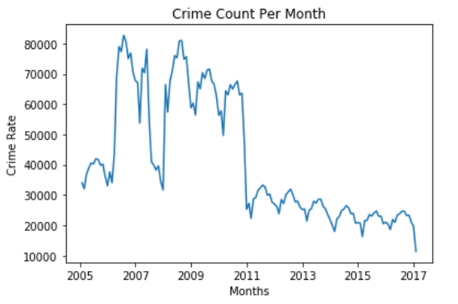
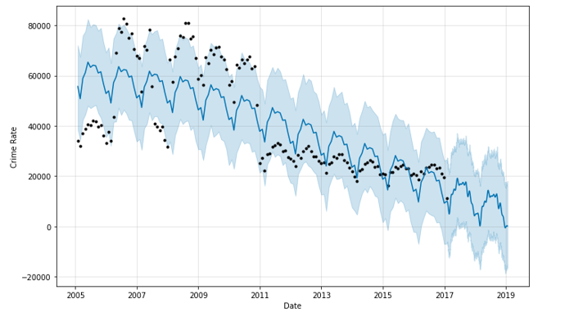
FACEBOOK PROPHET EXPECTED OUTPUT
FACEBOOK PROPHET

Slide 6
FACEBOOK PROPHET EXPECTED OUTPUT
Expected Outcome:
FUTURE
PAST

Slide 7
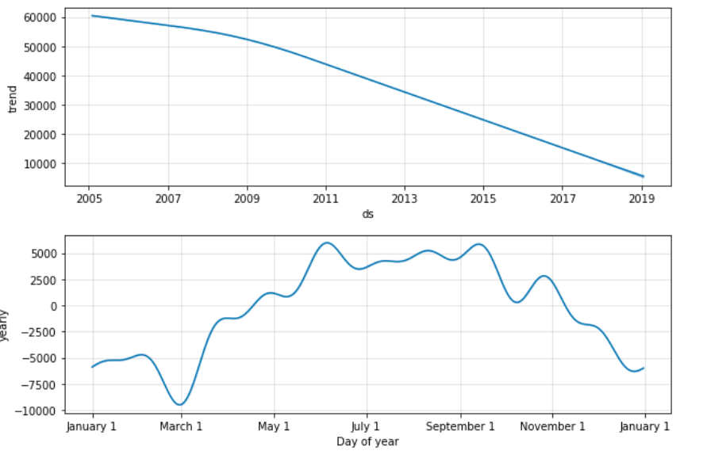
FACEBOOK PROPHET EXPECTED OUTPUT

